Slide 1
Business Finance Outlook - EDA Report using Python

Slide 2
Table of Content
  Project Overview and Objectives
  Project Architecture
  dataset - a glimpse
  Data Cleaning and handling missing values
  key visuals, KPIs and other important metrics with analyses
  Constraints
  Conclusion

Slide 3
Project Overview and Objectives
This project involves analyzing a comprehensive financial dataset of a retail business across multiple years (2023–2029).
The key objectives are to:
  Understand trends across time, regions, product categories, and sales channels
and find out insights.
  Evaluate profitability and increase cost efficiency from the insights.
  Uncover actionable insights for long term strategic planning and resource allocation.

Slide 4
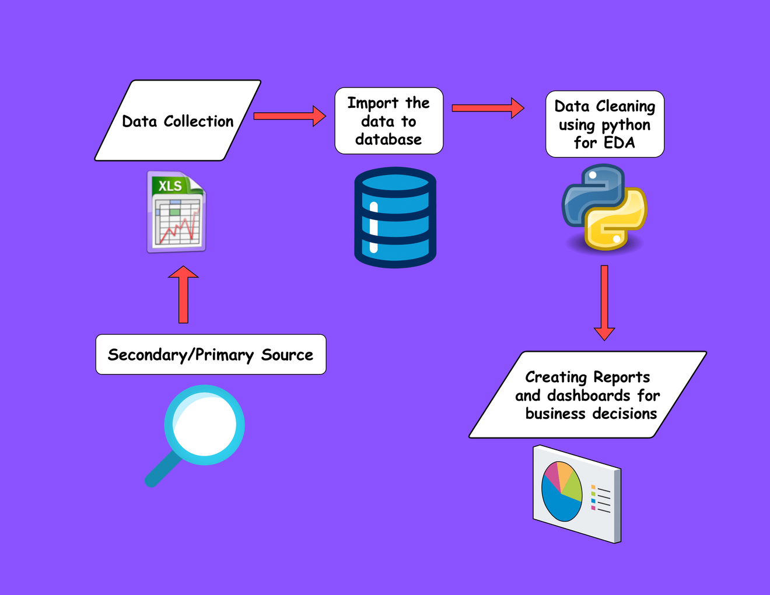
Project Architecture

Slide 5
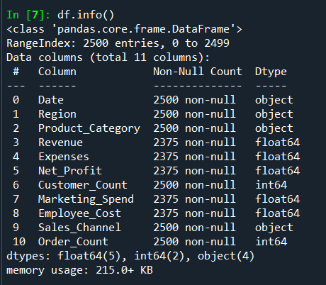
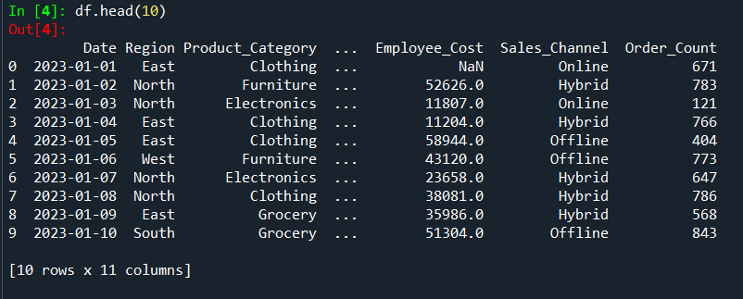
dataset - A glimpse
Dataset contains 2500 rows and 11 columns namely Date, Region, Product_Category, Revenue, Expenses, Net_Profit, Customer_Count, Marketing_Spend, Employee_Cost, Sales_Channel and Order_Count.
  Time frame: 2023-2029
key categorical variables:
  Product Categories: Grocery, Electronics, Clothing, Furniture
  Sales Channels: Online, Offline, Hybrid
  Regions: East, West, North, South

Slide 6
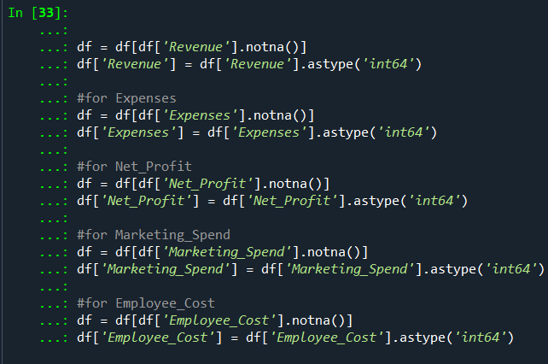
Data Cleaning and handling missing values
step 1: Dealt with NaN values to get rid of them.

Slide 7
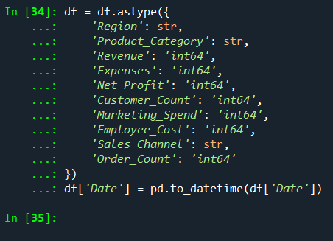
Data Cleaning and handling missing values
Step 2: Changed datatypes to string, integer, wherever needed.

Slide 8
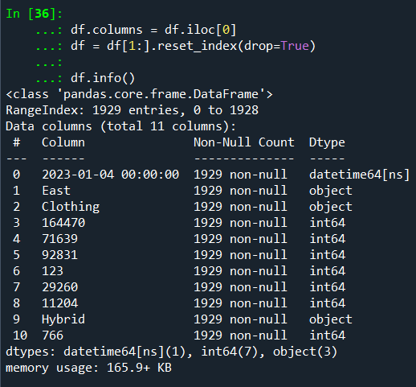
Data Cleaning and handling missing values
Step 3: Promoted first row as header (To be done right before importing data to any BI tool like PowerBI).
At last, we can see 1929 rows(initially 2500, which suggest data entry errors), which we will be using for initial Data visualization, EDA, Univariate, Bivariate, multivariate and categorical analyses further.

Slide 9
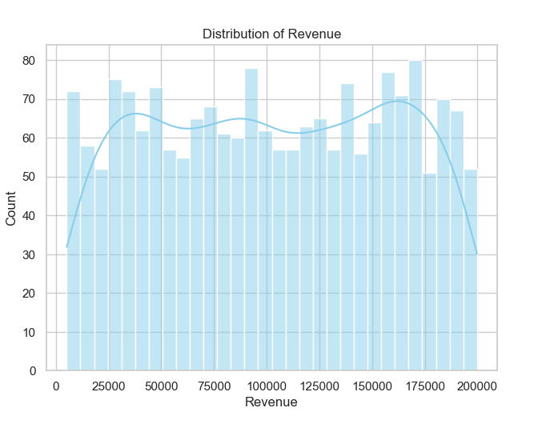
key visuals, KPIs and other important metrics with analyses
univariate analysis
  Revenue distribution
  The KDE line has two visible peaks—one around ₹40,000–50,000, and another around ₹160,000–170,000. This suggests a bi-modal distribution, indicating two distinct groups of transactions or customer segments:
A. Lower-revenue transactions (possibly low-cost product categories like groceries or small electronics).
B. Higher-revenue transactions (Bulk orders)

Slide 10
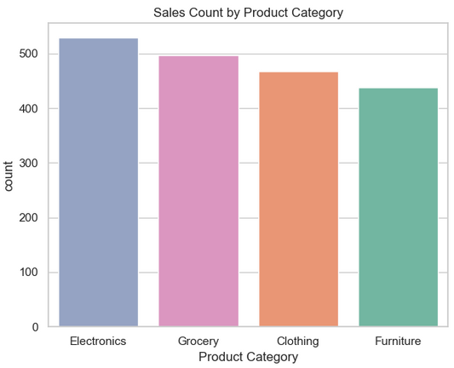
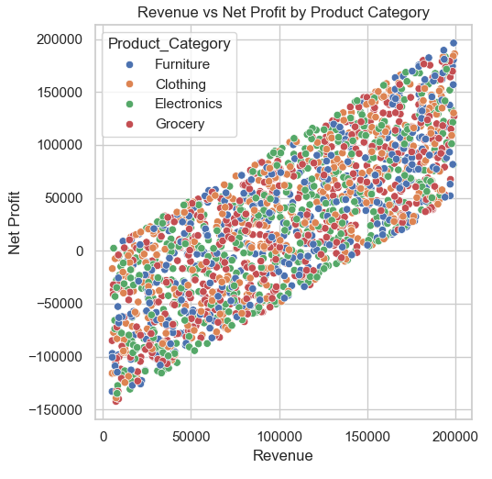
key visuals, KPIs and other important metrics with analyses
2. Sales count by product category
  We can see the highest sales count by product category is electronics.
  Also, we can infer that there’s an increasing trend in sales count from furniture, clothing, grocery to electronics.
Bivariate Analysis
  Revenue vs Net_Profit by product Category
  Plot shows a clear, strong positive correlation between Revenue and Net Profit. As revenue increases, net profit also tends to increase.
  There is no single category dominating any particular part in this plot.

Slide 11
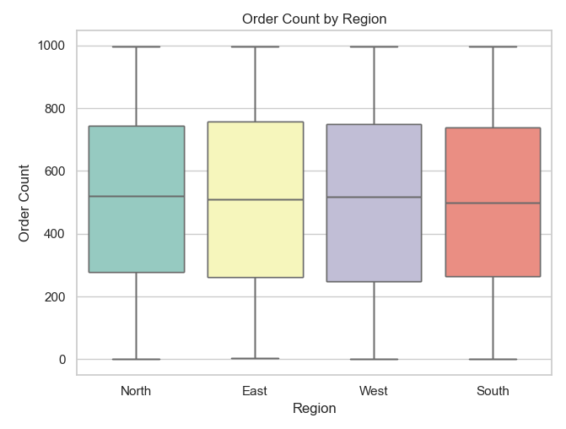
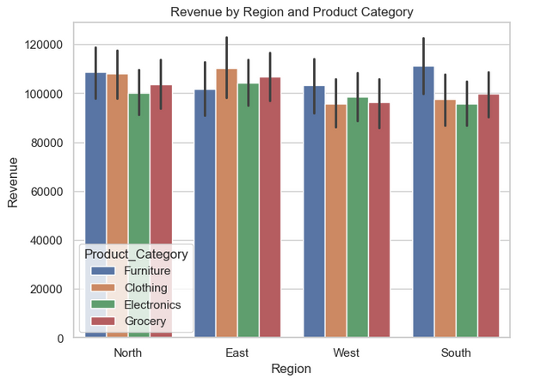
key visuals, KPIs and other important metrics with analyses
2. Order count by Region
  We can see that all four regions are similar in case of IQR, median and spread.
  Symmetry and similarity of this box plot suggest that the data is well balanced, which means there is quite small chance of outliers.
Multivariate Analysis
1. Revenue by region and Product category
  For each product category, revenue is similar with only minor differences.
  In three product categories, East region is leading but the difference is not very high and noticeable.

Slide 12
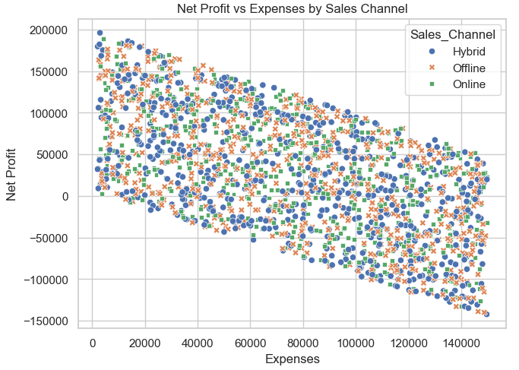
key visuals, KPIs and other important metrics with analyses
2. Net Profit vs Expenses by Sales Channel
  Strong negative correlation between expenses and net profit can be seen which means higher expenses generally lead to lower net profit.
  No single sales channel dominates either high or low profit/expense areas.

Slide 13
Constraints
While the dataset tries give a complete financial overview to the stakeholders, several constraints may limit the depth and accuracy of insights.
  The absence of external economic indicators—such as inflation rates, seasonality effects, and competitive landscape—prevents a more contextualized interpretation of metrics and KPIs.
  Dataset includes information by product categories, however, it lacks product-level granularity, which limits the ability to drill down into high- or low-performing SKUs.
  Lack of integration with inventory or supply chain data restricts a better view of operational efficiency and logistics-related costs.

Slide 14
Conclusion
  Revenue distribution has two peaks (one lower and one higher) indication two sets of customers or orders volumes or products.
  Electronics is the most sold product category.
  Sales and order counts are evenly distributed across all regions.
  All product categories and regions generate similar revenue, with only minor differences.
  Higher expenses generally reduce net profit, regardless of sales channel, and there is no clear winner among channels.
  The data shows stability and balance, with no extreme outliers or dominant regions, categories, or channels.

